Slide 1
Bus Queuing System
Serra, Vincent Franklin T. Magcayang, Aaron Jester
Gomez, Raxell

Slide 2

Project Context
Because of the growing population of Asia Pacific College,
surely there will be a lot of students/staffs that needs to line up in order to ride the shuttle.
The problem is, due to fear of not falling in line early, even though the shuttle’s not there, students/staffs will fall in line early as they can and won’t have the time to do the things that they need (eg. Eat, appointments with professors, projects meetings).

Slide 3
Project DESCRIPTION
Bus Queue Monitoring System will provide hassle-free, convenient application
so students can use the time for other important things to be done rather than queuing. Not only students have the benefits in this project but also the staffs/professors for they can use the time on their appointments with their students. They can buy food at the cafeteria instead of queueing. This project may also come to use. In addition, to obtain new knowledge of what/when is the most students that will queue will do their best to follow schedule in-case of emergency maintenance of other buses. To provide data of when are the most students/staffs queue in a specific time

Slide 4
Objectives
To develop and create a convenient queuing system for Asia Pacific College students and staffs
To develop and create an application where students/staffs can fall in line to ride the shuttle without going down.
To lessen the students who fall in line to ride the bus.

Slide 5
Scope and limitations
It gives reservation umber to users who are to use the bus services
The following constraints apply to the Bus Queue System. As project planning beings and more constraints are identified, they will be added immediately.
Asia Pacific College has the limited area of internet connectivity making the application not accessible (only for the students/staffs that doesn’t have mobile data) anywhere/anytime at the said school.
The Internet Connection will only be available in Cafeteria & 7th floor (library)

Slide 6
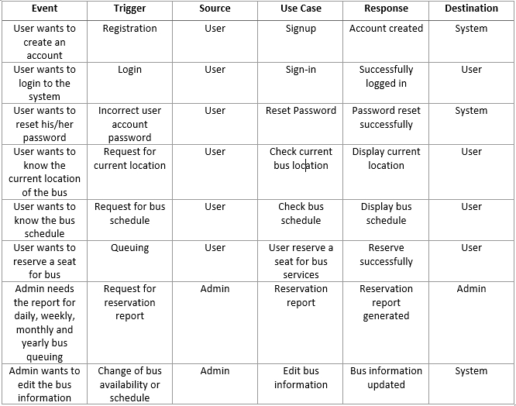
Event table

Slide 7
List of Diagrams

Slide 8
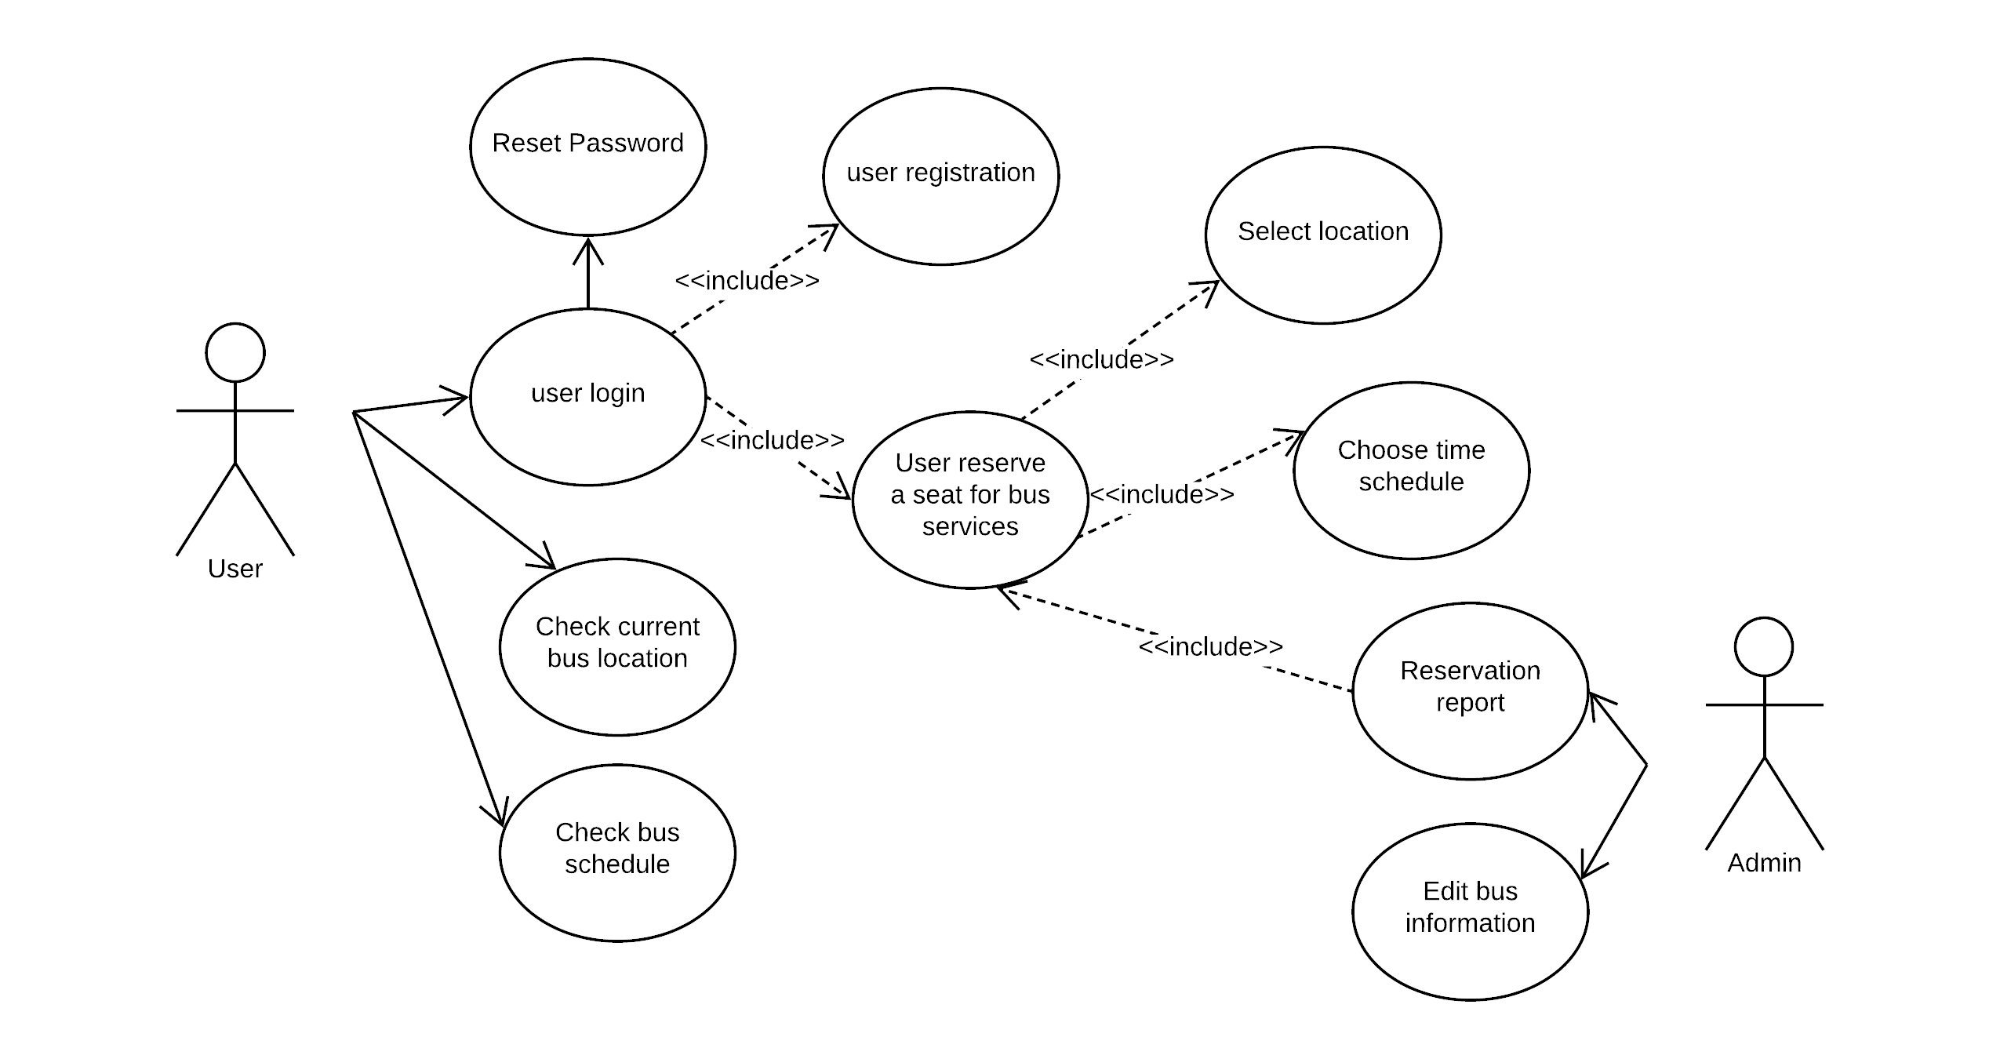
Use Case Diagram

Slide 9
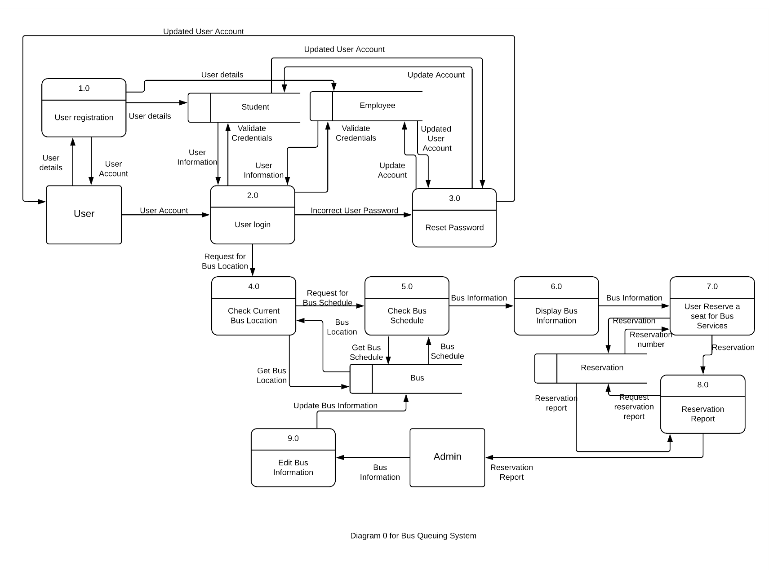
Data Flow Diagram

Slide 10
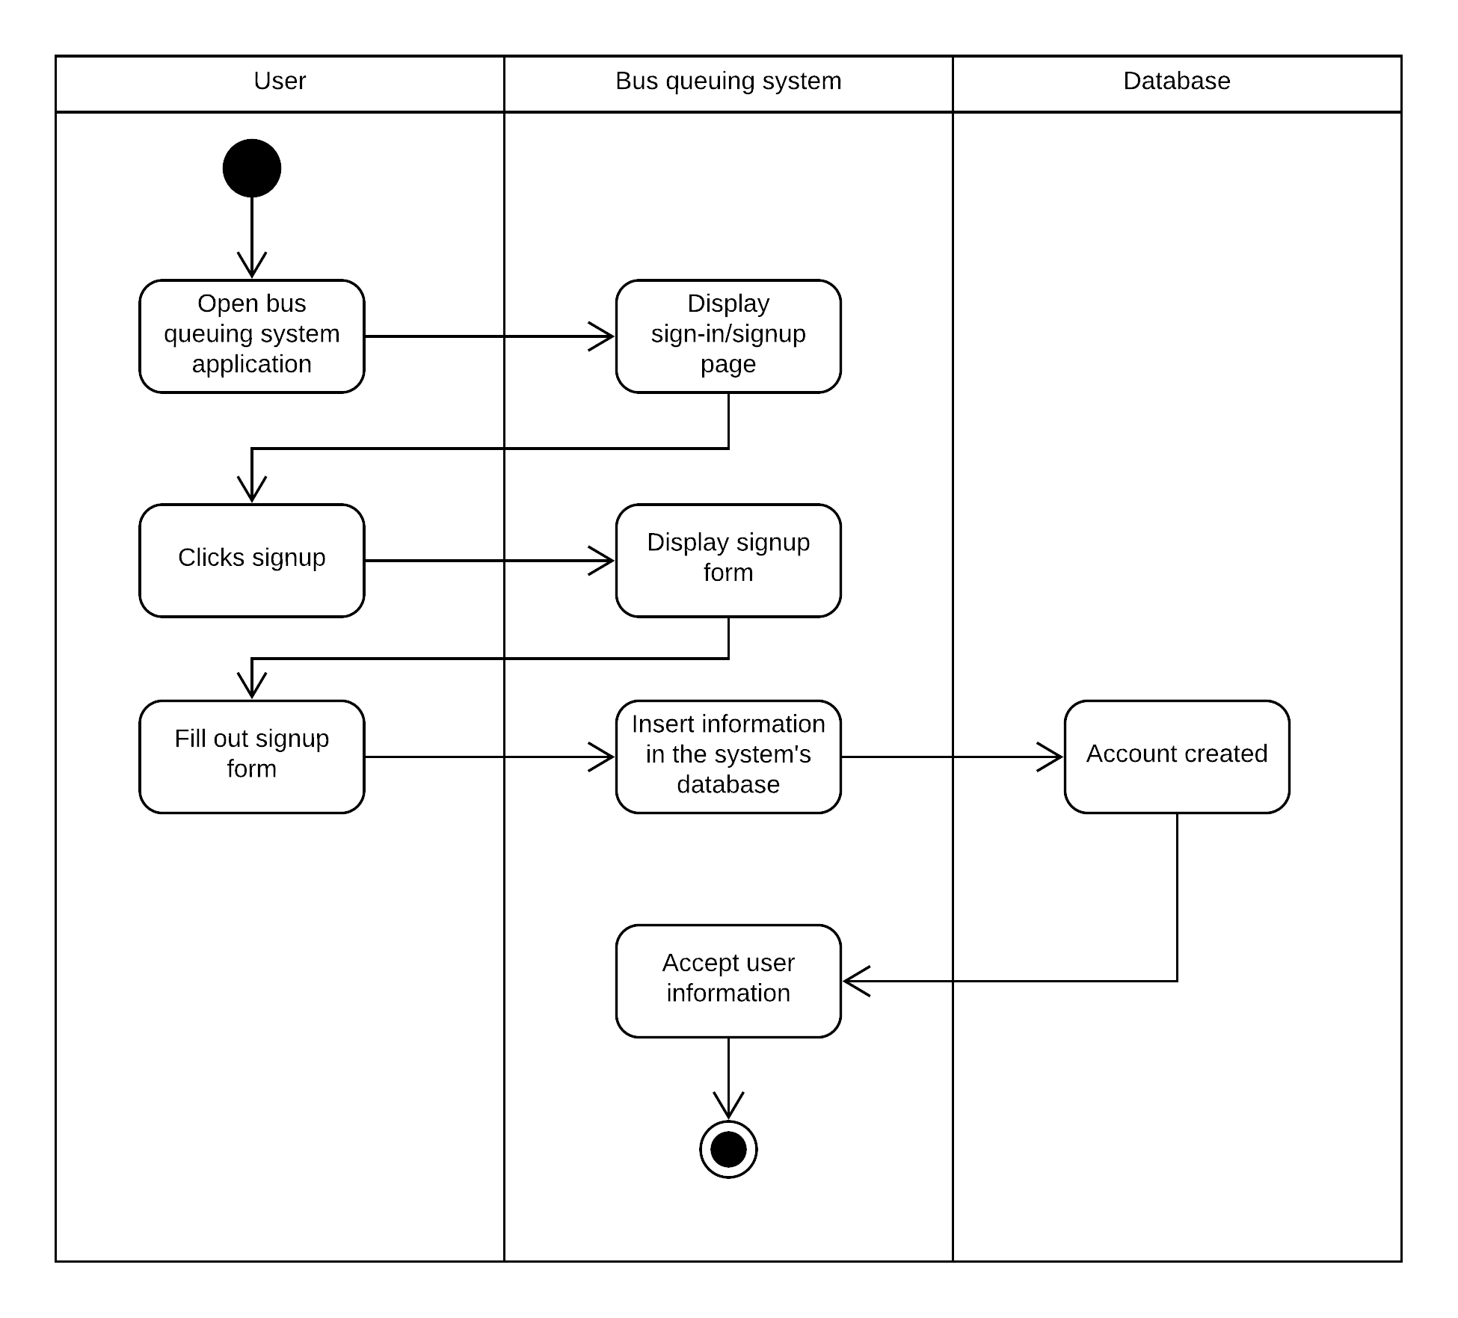
User Registration

Slide 11
Activity Diagram

Slide 12
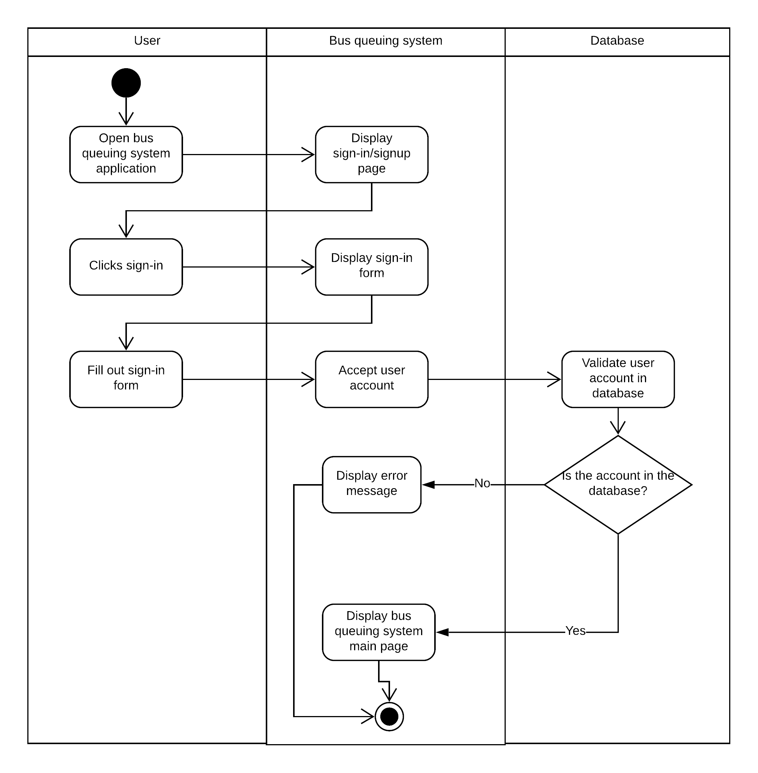
User Login

Slide 13
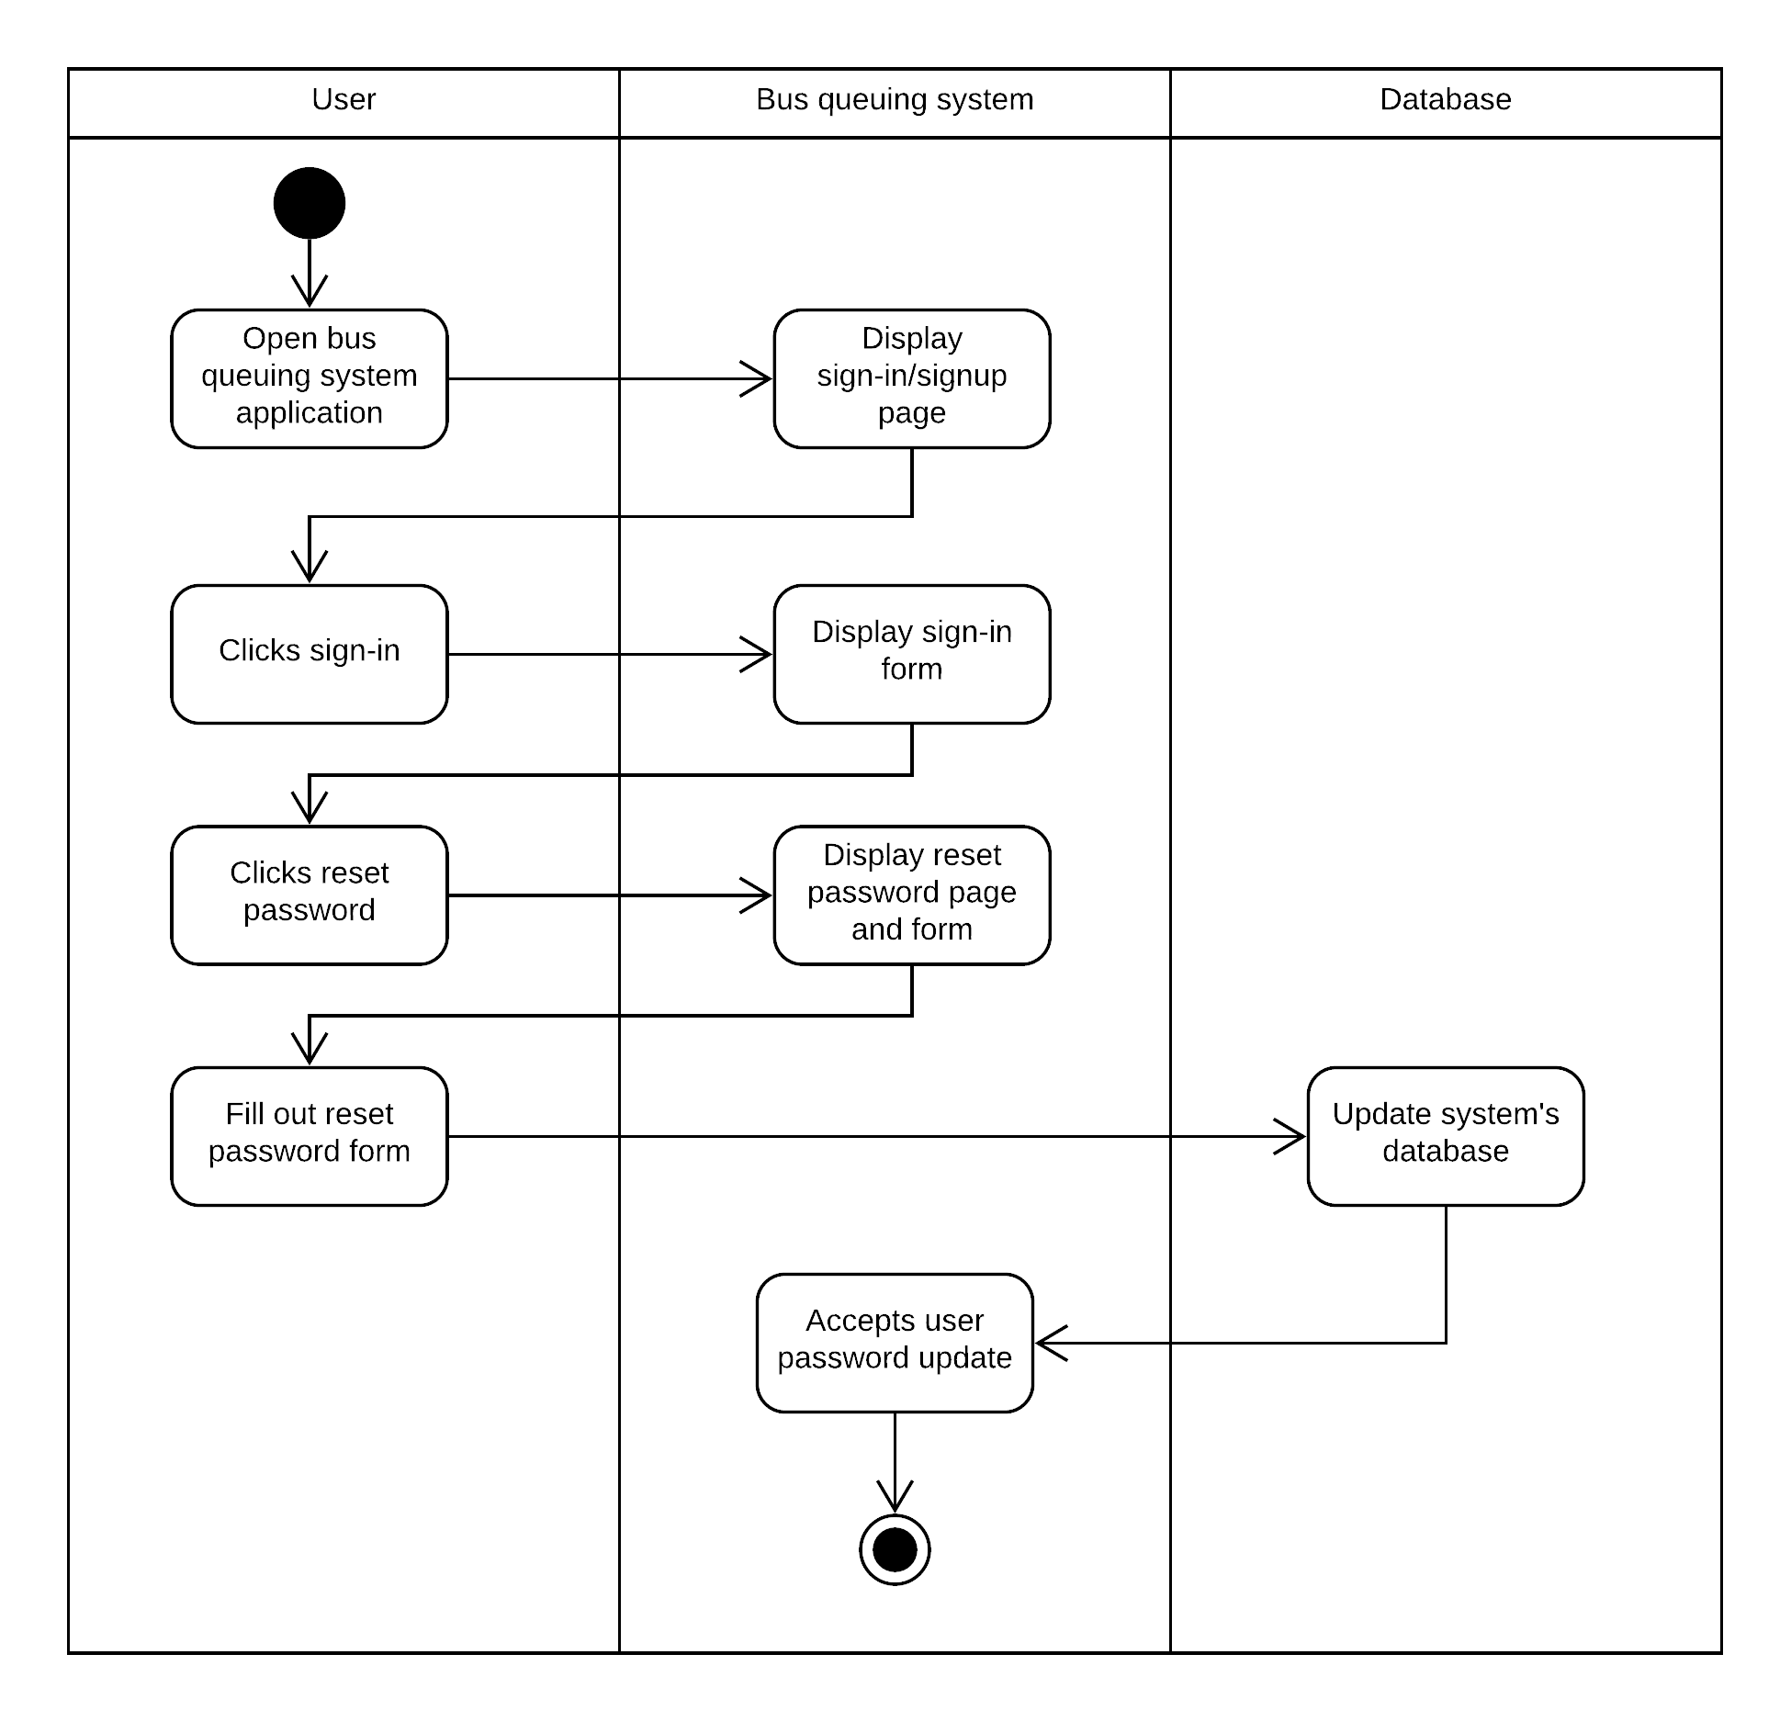
Reset Password

Slide 14
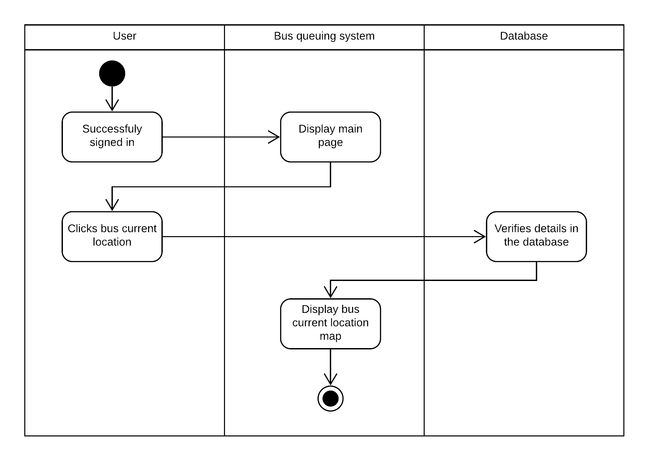
Bus Location

Slide 15

Bus Schedule

Slide 16
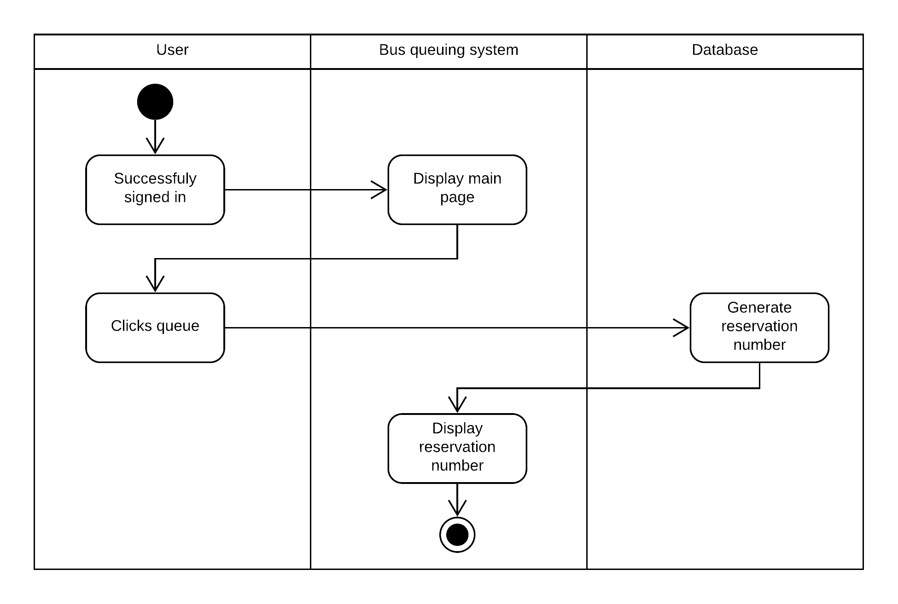
Reserve

Slide 17
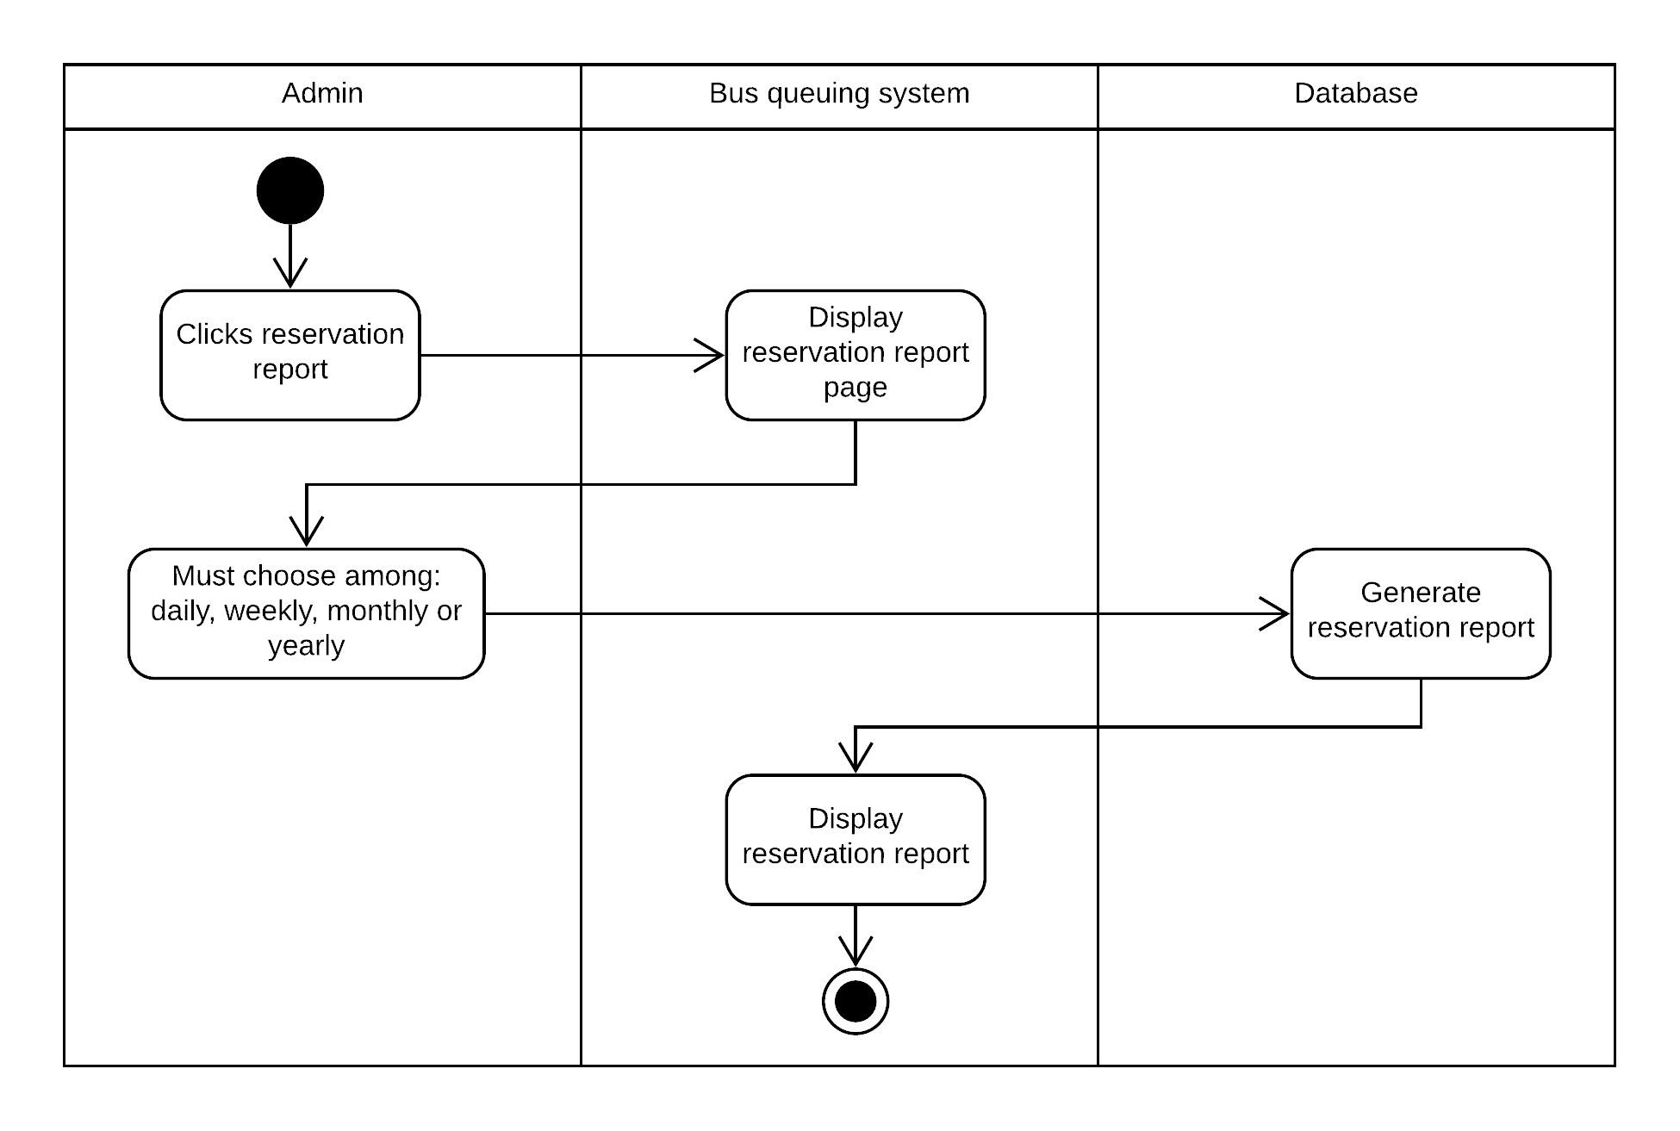
Reservation Report

Slide 18
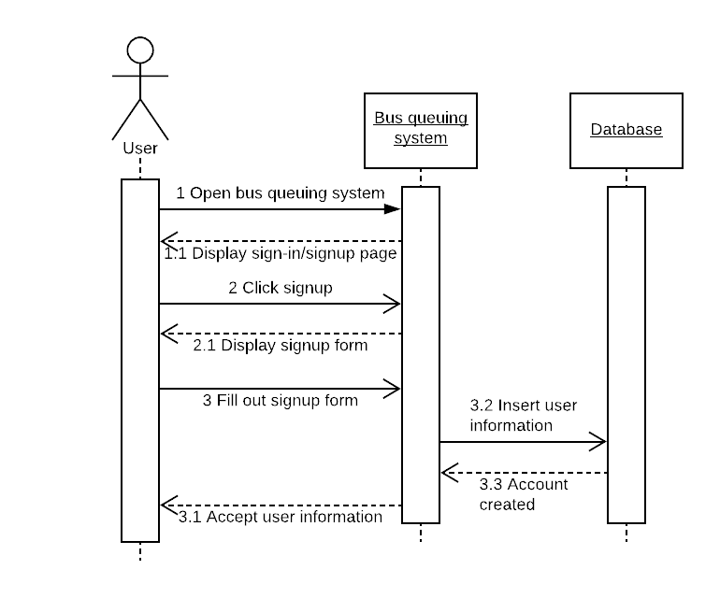
User Registration

Slide 19
Sequence Diagram

Slide 20
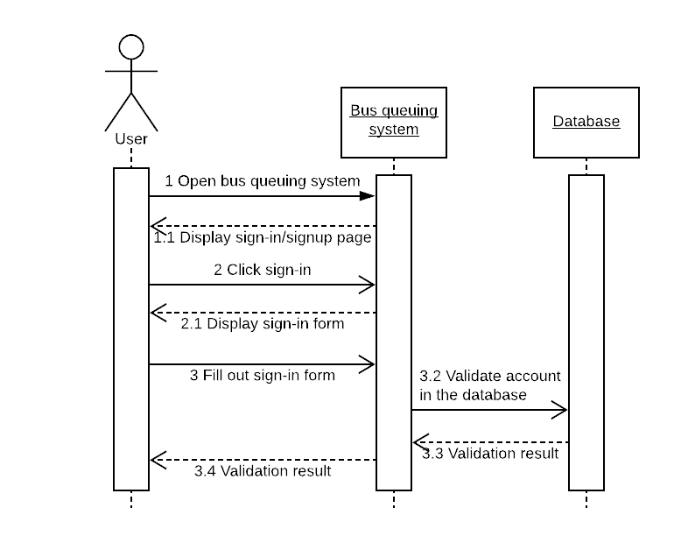
User Login

Slide 21
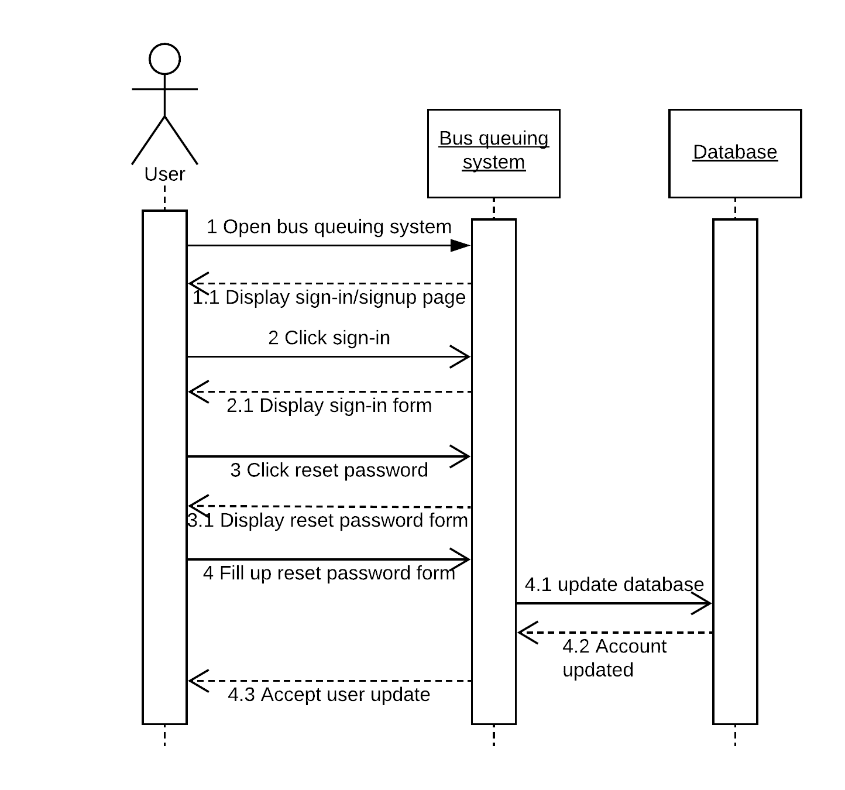
Reset Password

Slide 22
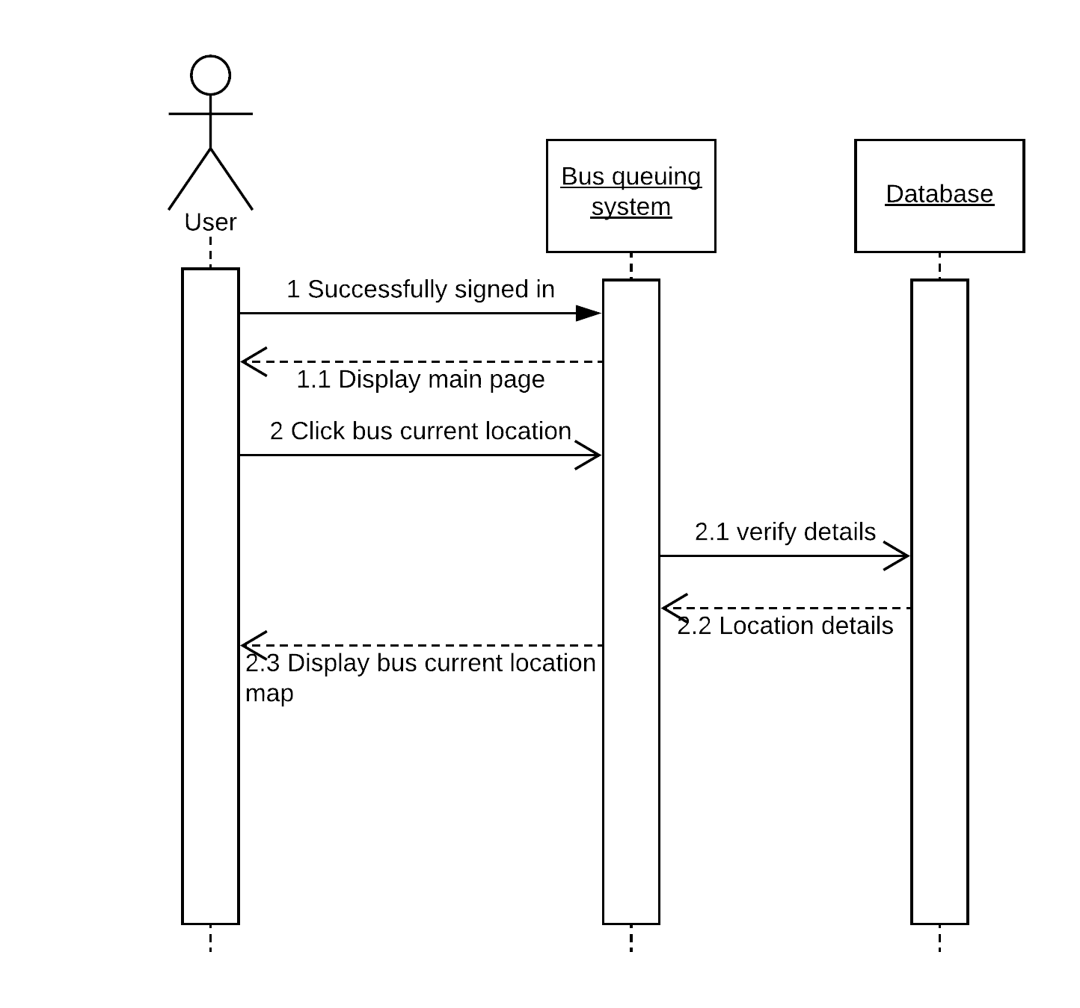
Bus Location

Slide 23

Bus Schedule

Slide 24
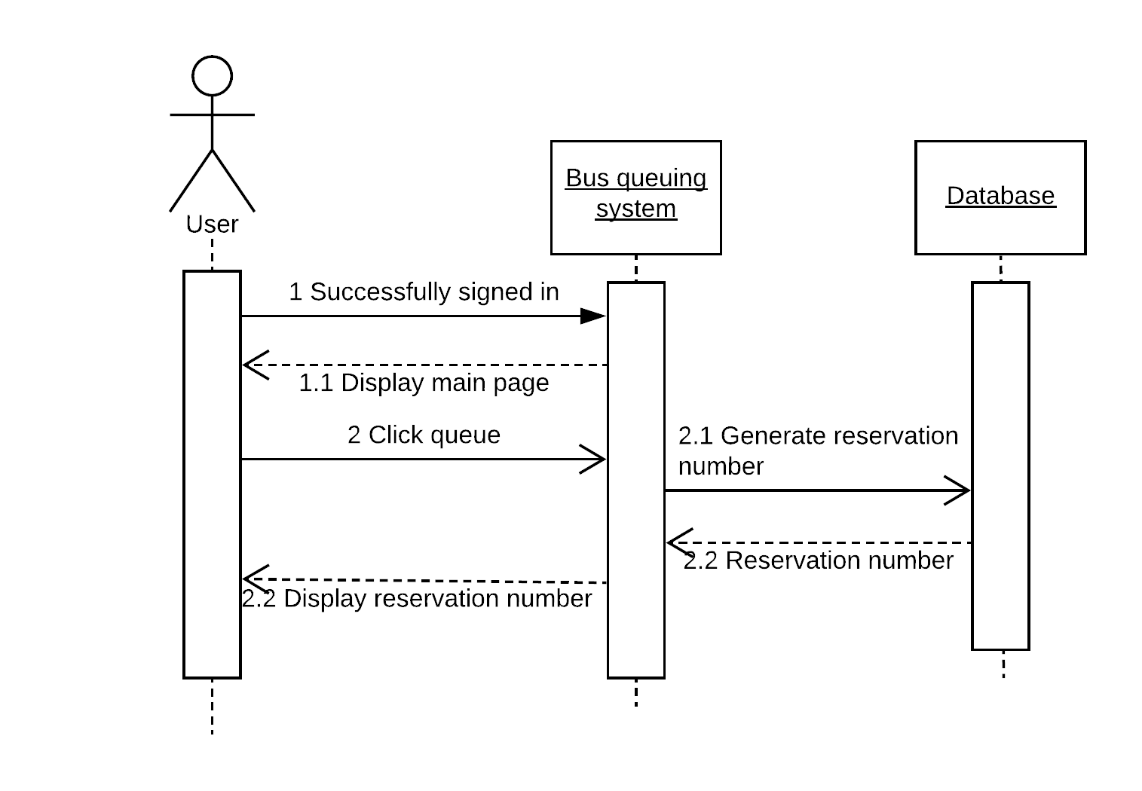
Reserve

Slide 25
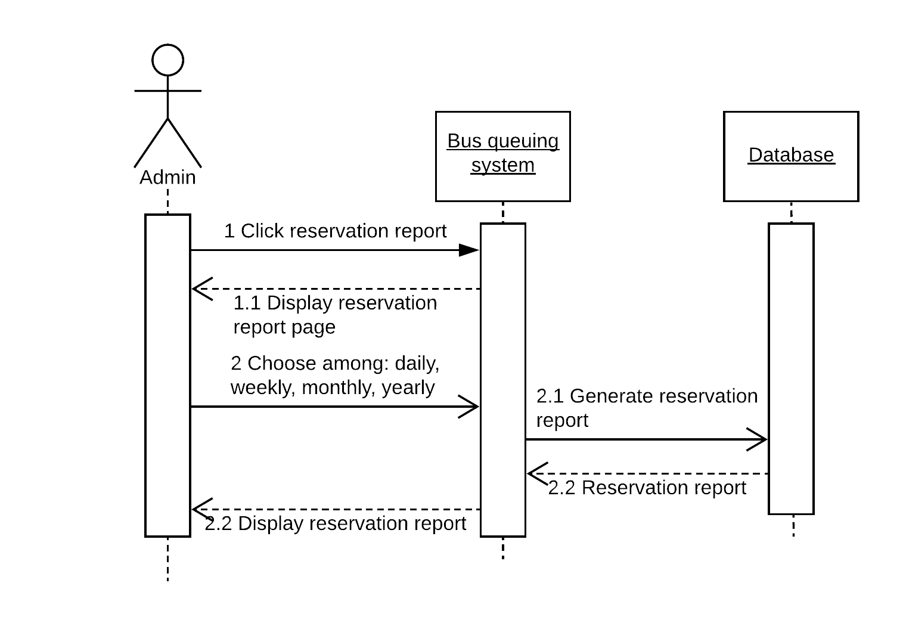
Reservation Report

Slide 26
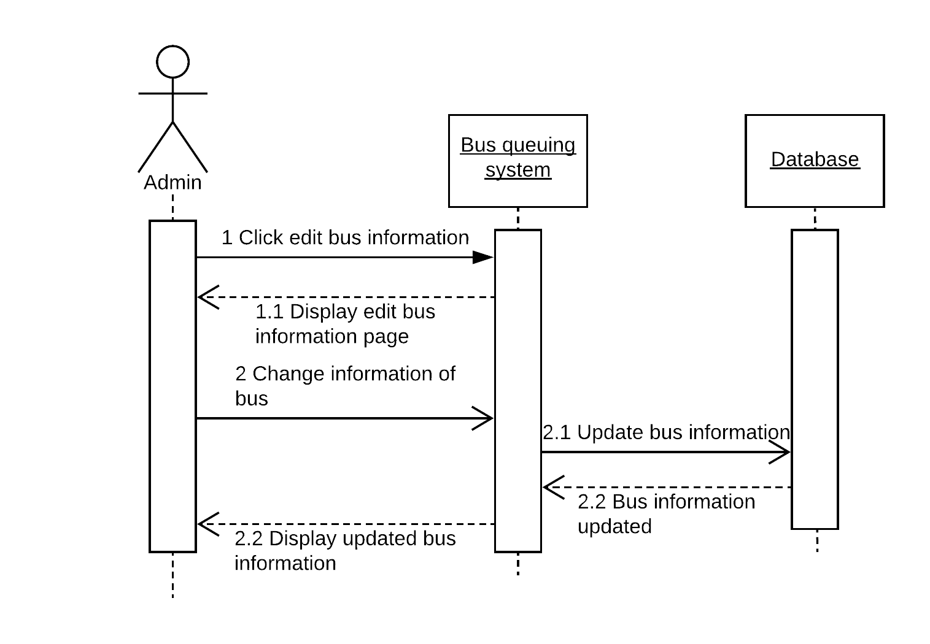
Edit Bus

Slide 27
Entity Relationship Diagram

Slide 28
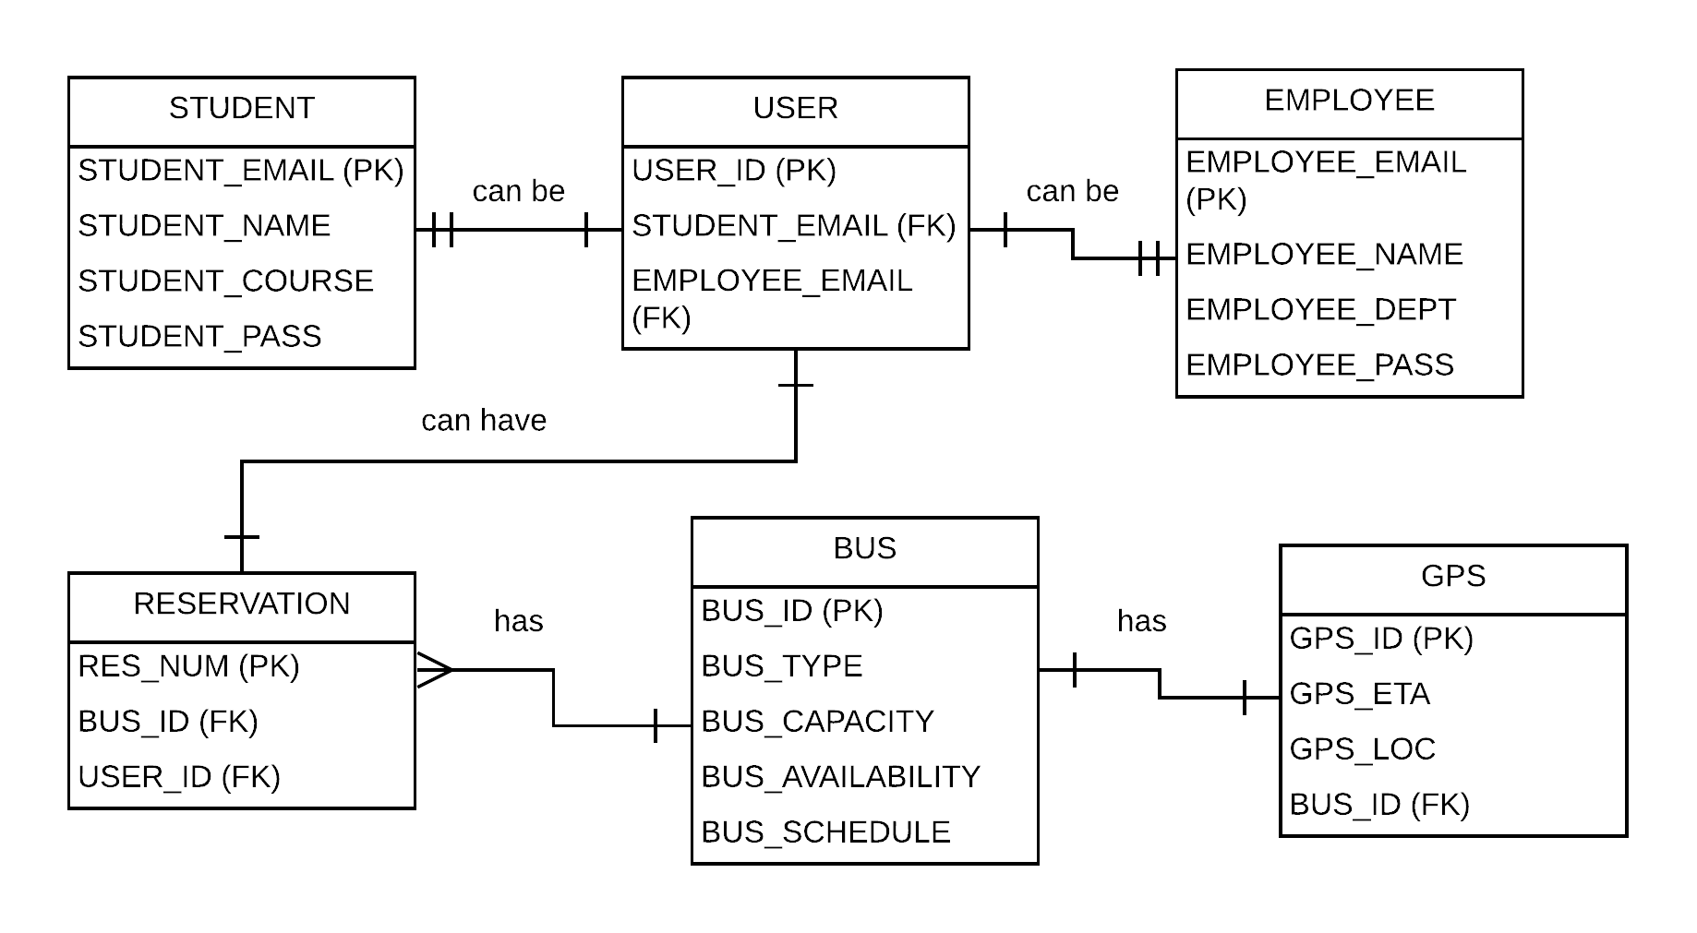

Slide 29
State-Machine Diagram

Slide 30
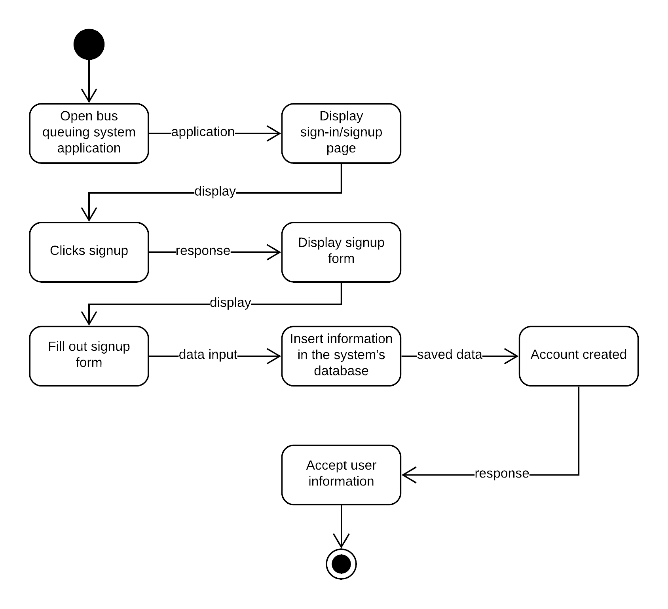
User Registration

Slide 31
User Login

Slide 32
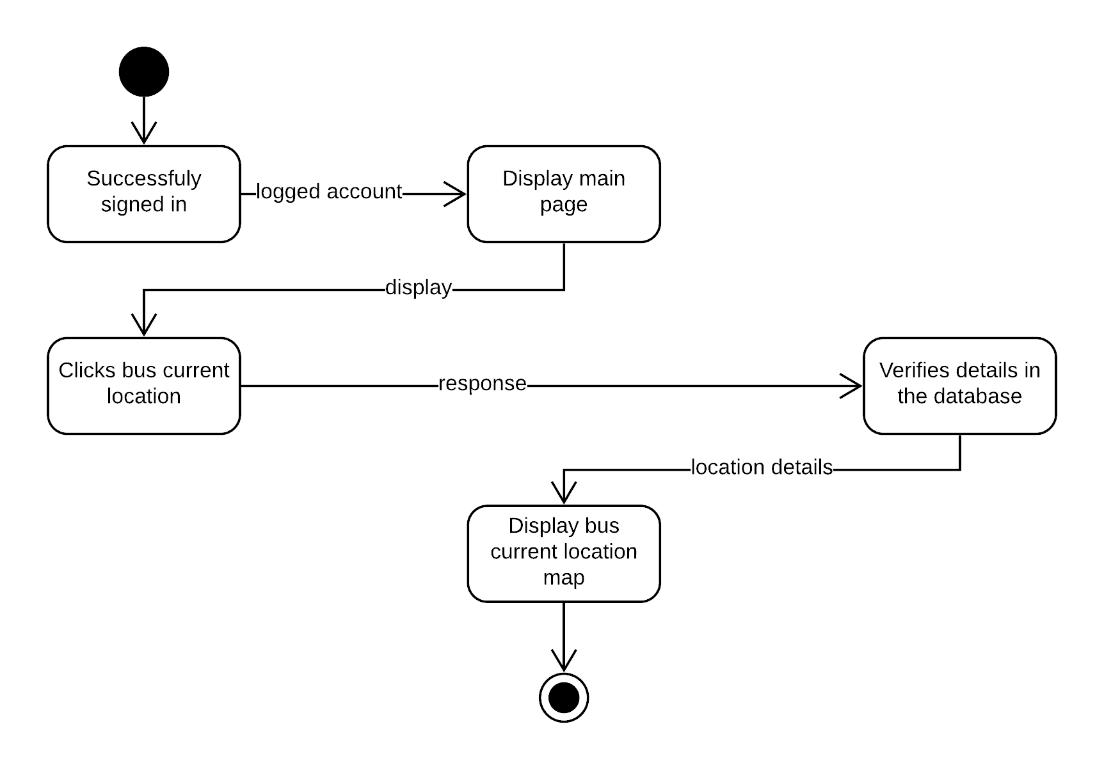
Bus Location

Slide 33

Bus Schedule

Slide 34
Reserve

Slide 35
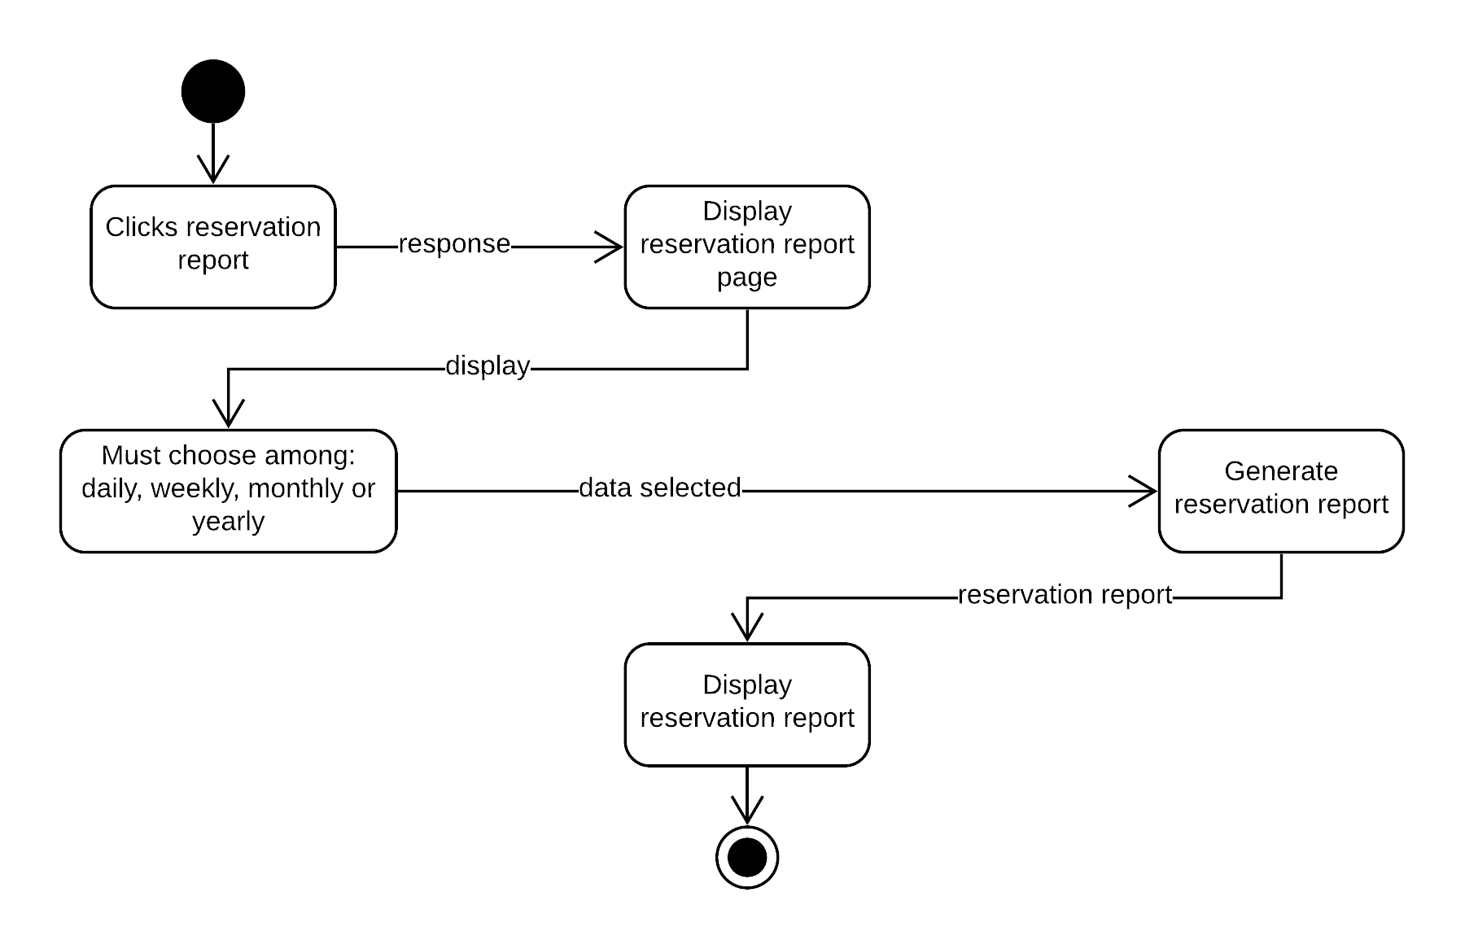
Reservation Report

Slide 36
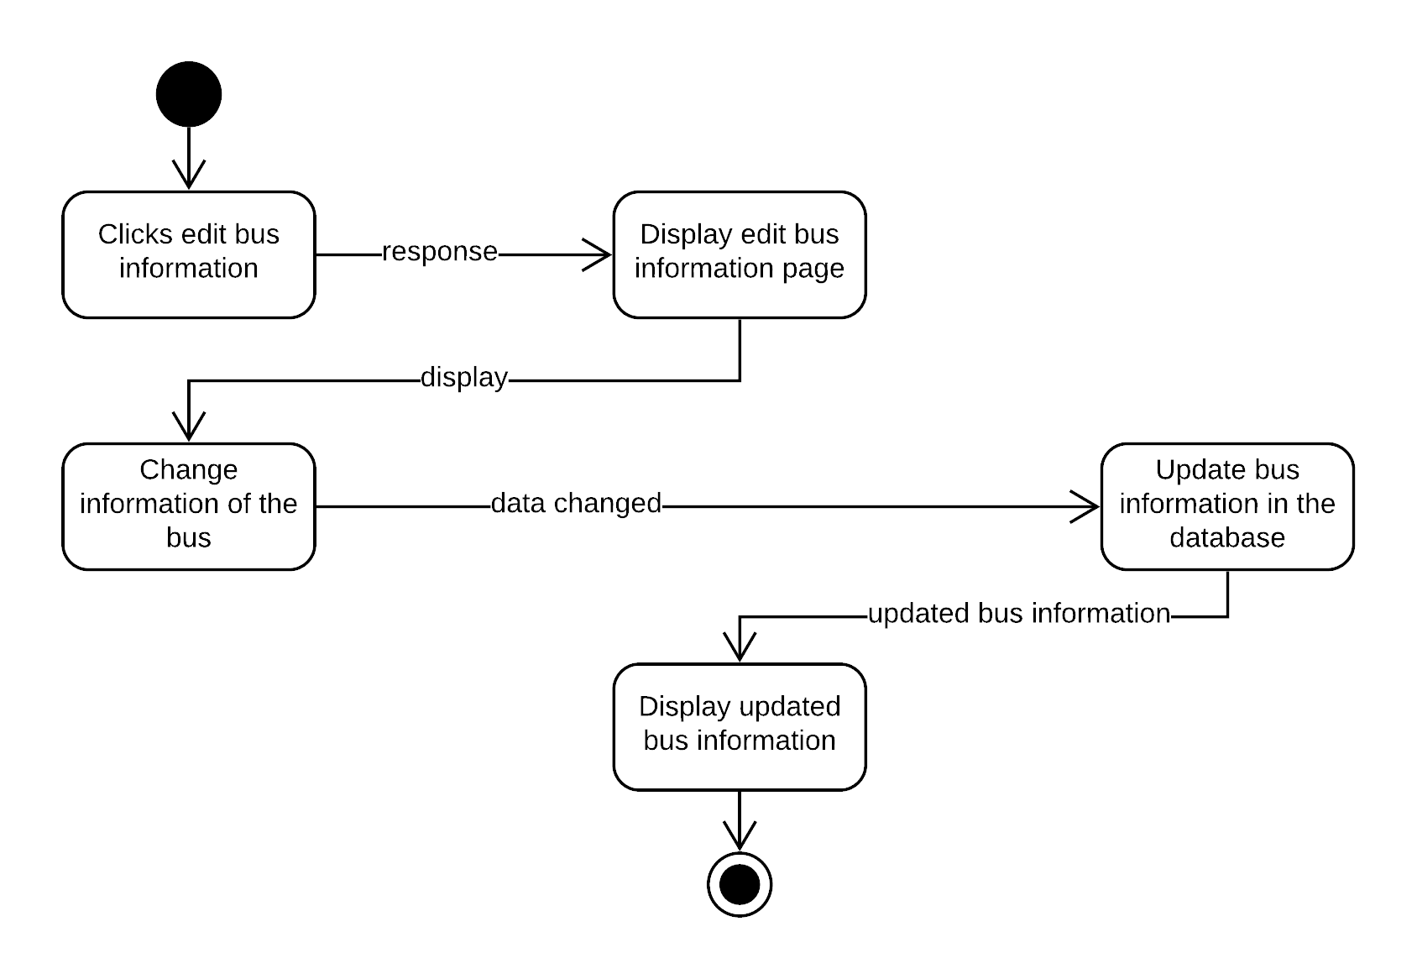
Edit Bus

Slide 37

User Registration

Slide 38
Timing Diagram

Slide 39
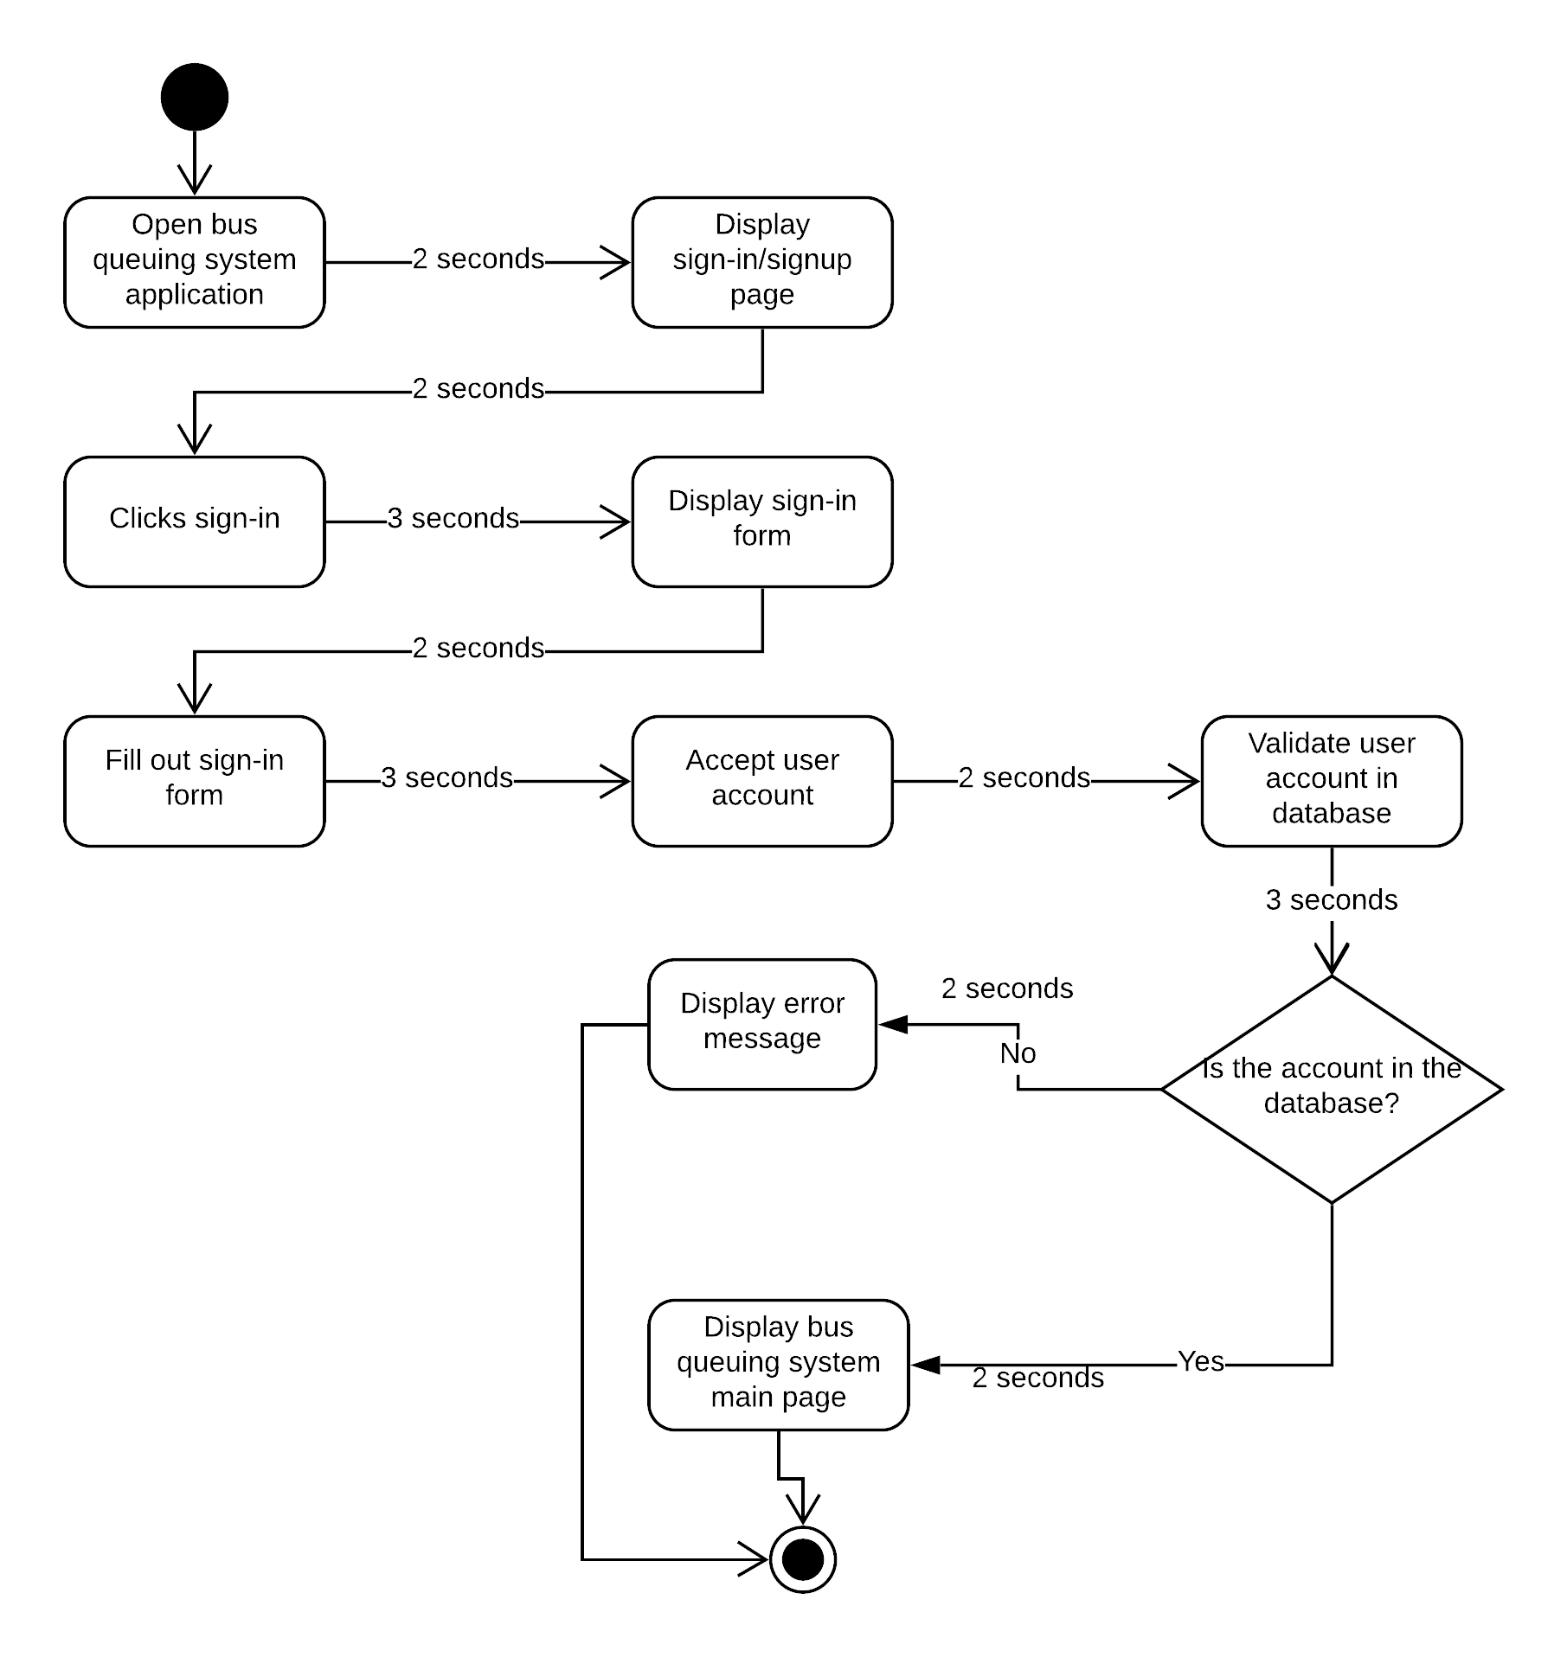
User Login

Slide 40
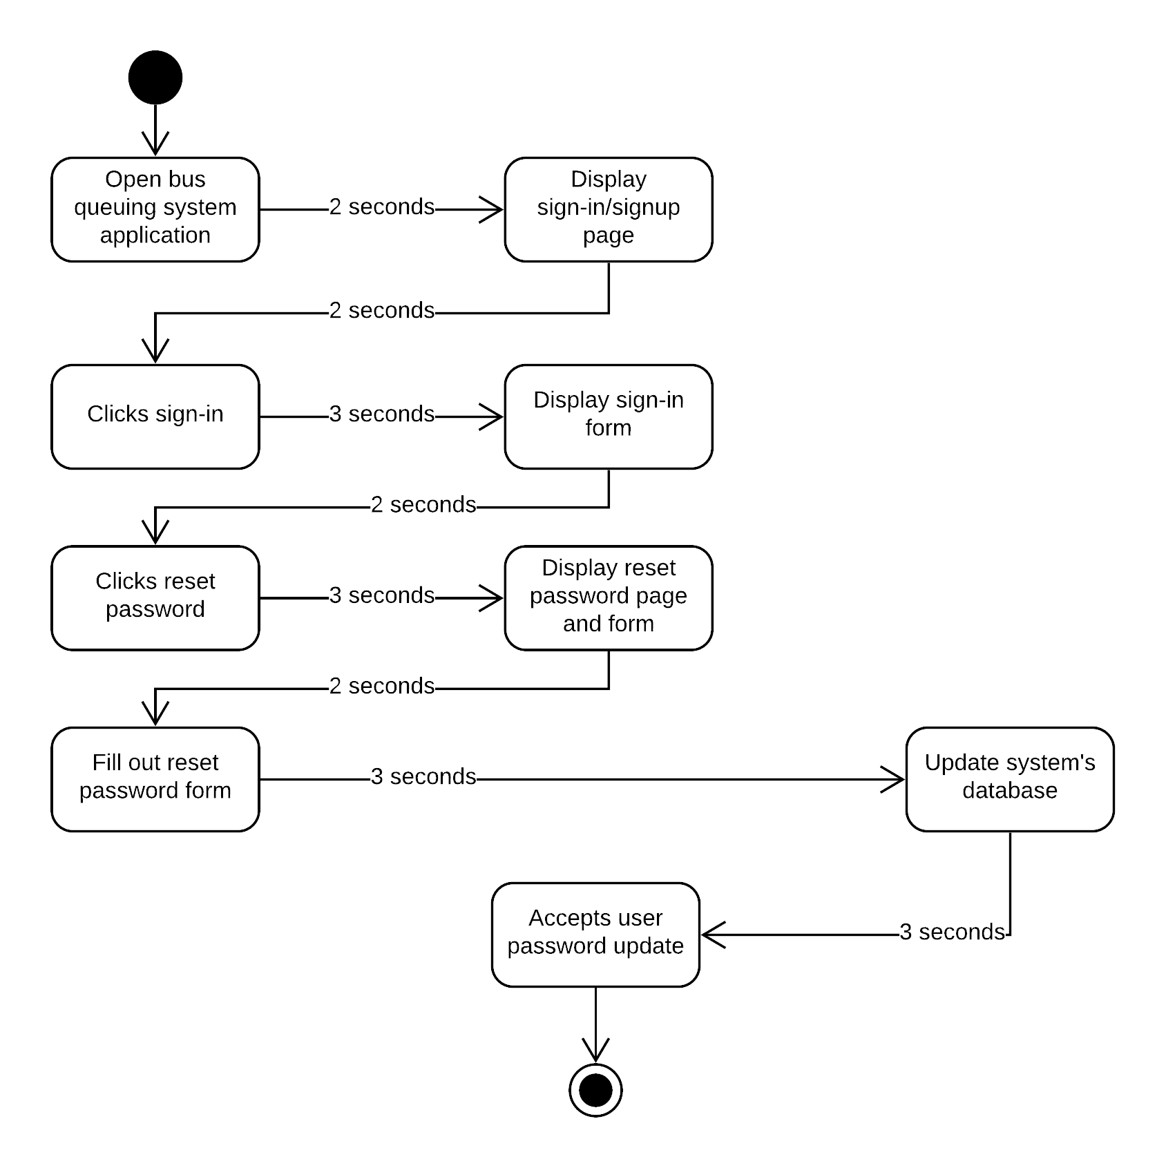
Reset Password

Slide 41

Bus Location

Slide 42

Bus Schedule

Slide 43
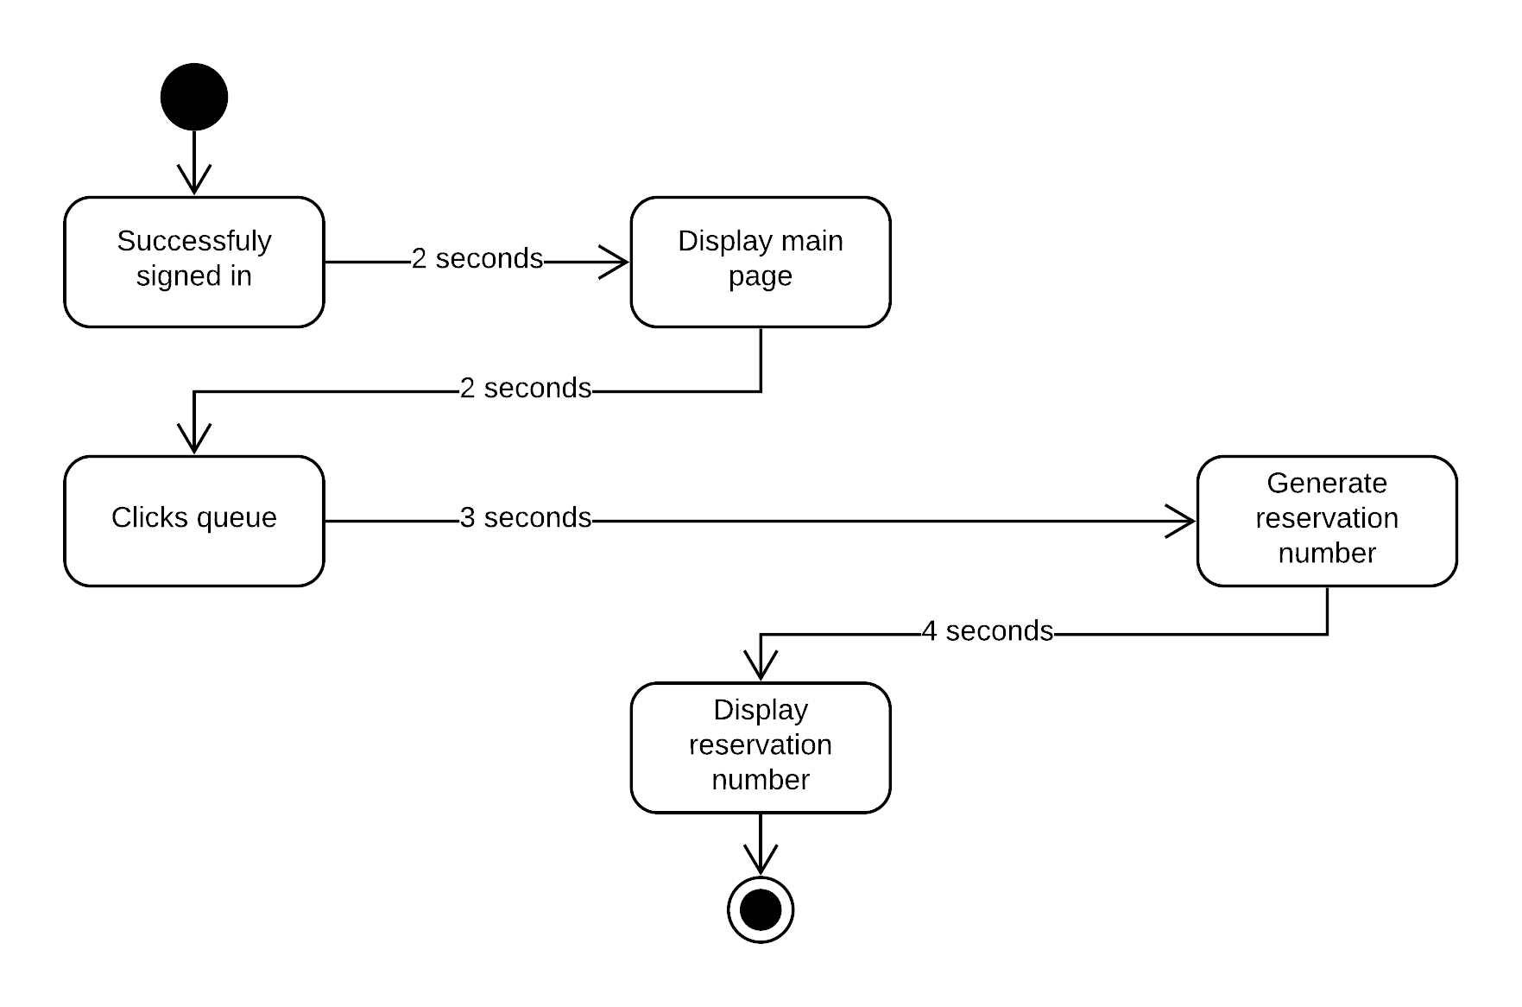
Reserve

Slide 44

Reservation Report

Slide 45

Edit Bus

Slide 46
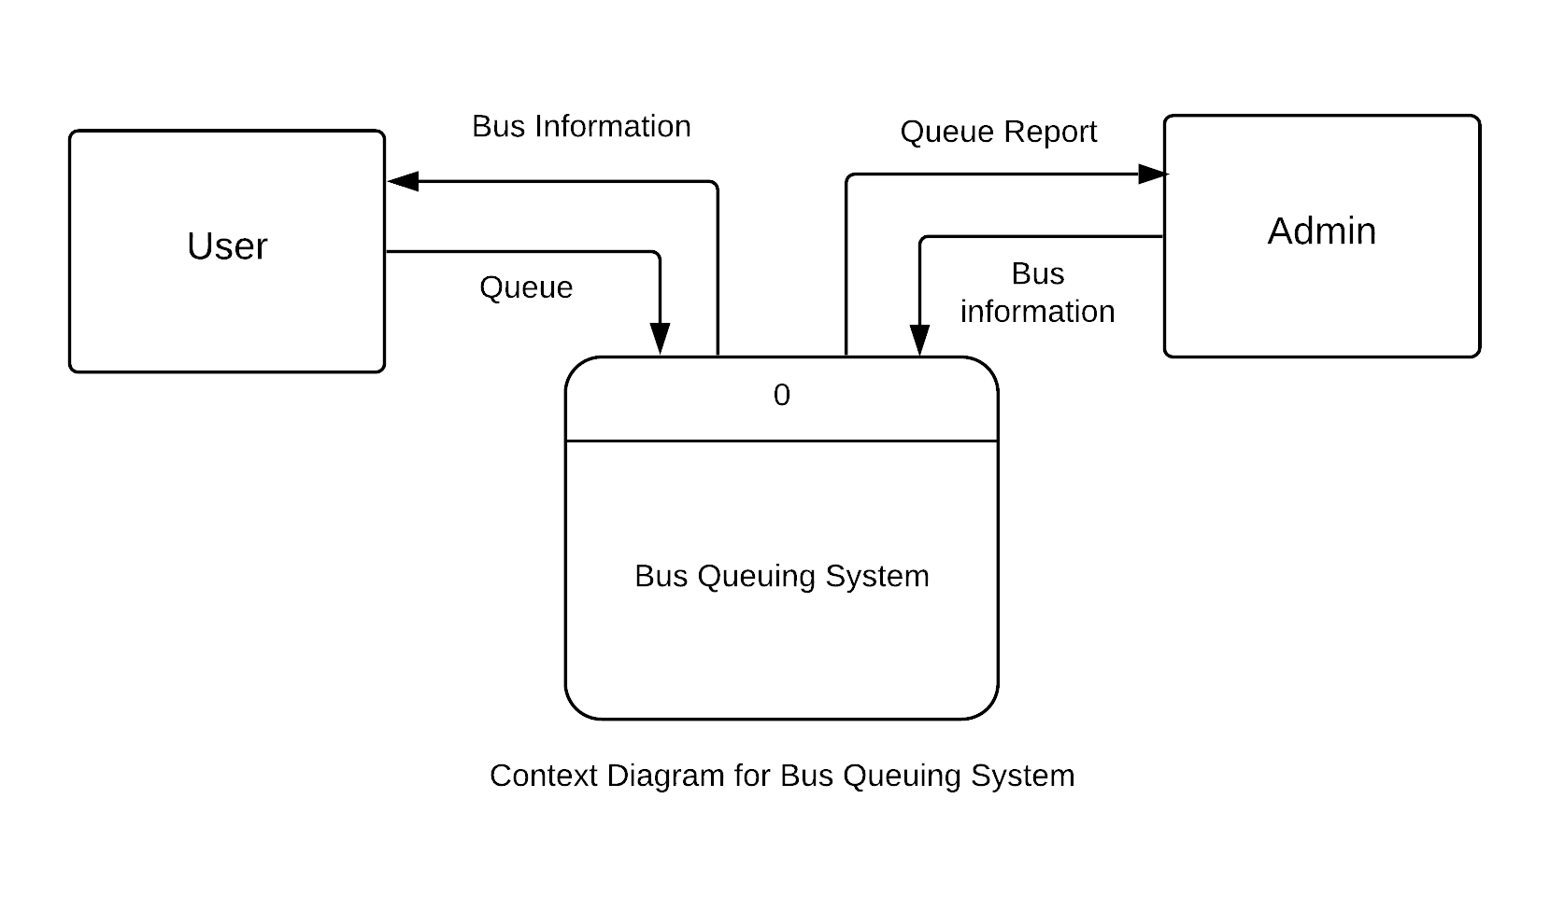
Context Diagram

Slide 47
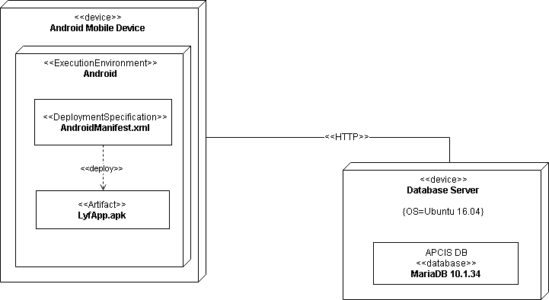
Deployment Diagram

Slide 48
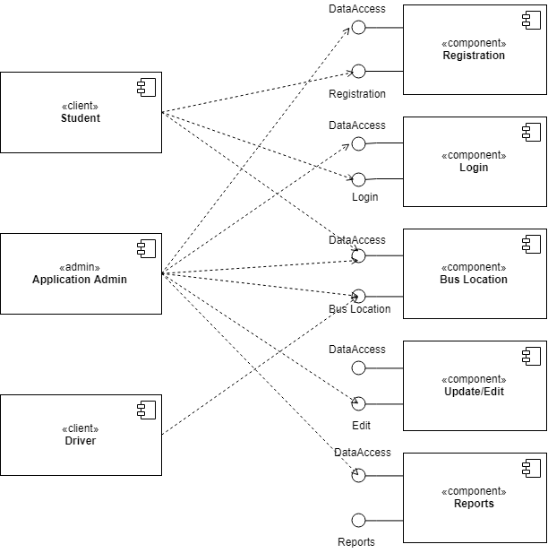
Component Diagram

Slide 49
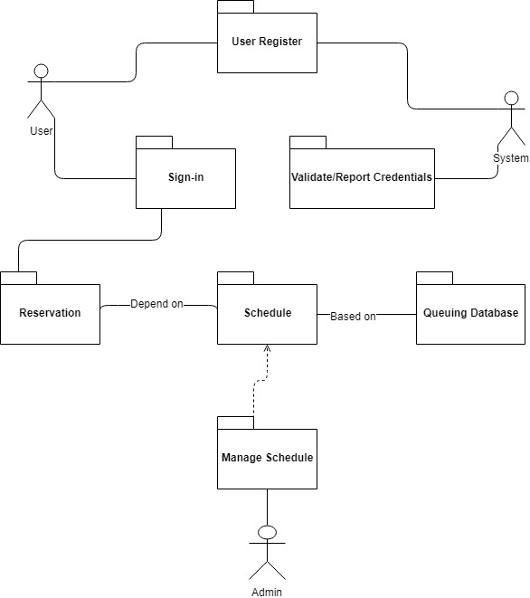
Package Diagram

Slide 50
Gap Analysis
User Requirements | Current System | Proposed Changes
The user needs to have an Android phone and bus queuing system application The user requires to have WIFI or data connection to use the application The user requires to click queue through app to be able to ride a bus | User queue to use bus services Users are not aware of the exact location and schedule of the bus Admins are not aware of the number of passengers riding the bus daily, weekly, monthly and/or yearly Users can cut in line | The proposed application lets the user to create an account to be able to use the application The user must have WIFI or data connection to be able to catch data in the database The proposed application gives each user their corresponding queuing/reservation number to avoid cutting in line The proposed application provide reports for the administrator in order to monitor the number of bus users

Slide 51
SWOT Analysis
Strength | Weakness | Opportunities | Threats
Provides high level of convenience Strongly acknowledge the rules and regulation | Nonconformity with the current bus system Limited support from hardware/software providers Lack of Internet connection | Demand for use of bus services Innovation | Competition Users that are unengaged to the application

Slide 52
Conclusion & Recommendation
Conclusion
This system provides a hassle-free bus queuing system for Asia Pacific College. With this kind of technology, it serves as an answer to the lessen long lines and avoid waiting times of students and faculty.
Recommendation
With the evolution of technology, it is more convenient and time less process to do something if we, people, are to enhance and adopt it. Students and Employees of Asia Pacific College can be able to use their time effectively for the application provides technology-based queuing system which practice and value the rules and regulation of the institution. For anyone who wants to upgrade our system. We highly recommend developing a web based application so students who doesn’t have access to the internet can also use the application.

Slide 53
Data Gathering (Bus Driver)
Bus Driver : Mr. Rico
1. Bus Capacity
> Yellow (small) – 24
> White w/ ram logo – 40
> White (small)- 33
> Yellow (large) – 35
2. Do you think that the application will help improve the current bus process of APC?
> yes, it will be easier for them to facilitate the students/staffs for they don’t need to call if there’s still slot inside.
3. Any thoughts about the dividing of reservation to non app users to app users? (ex. White with ram = 40 , 30 seats is for app users while 10 seats is for non app users) (not recorded, forgot to turn on the recorder)
> It’s good because others still has the opportunity to ride the shuttle even though they are not using the application.
Comments: The group needs to broadcast that we will have an application like this to avoid confusion among the students/staffs.

Slide 54
Data Gathering (famous answers) (Survey) (50 recipients)
1. Anong oras ka nakarating sa pila?
2. Anong oras ka nakapasok sa pila?
3. Ilang minuto ka nag-intay?
> 10 mins +
4. Ano yung mga dapat sanang mga nagawa mo sa oras ng iyong pag-iintay?
> buys food, appointments with professors, studying
5. Sa tingin mo ba, kailangan ng application nga makakapag-queue sayo kahit nasang lugar ka man ng school, Bakit?
> Yes, for us to be able to manage our time wisely.
PS. Monday, Tuesday, Thursday, Friday (1:30PM-5:30PM) has the most hassle timeslot.

Slide 55
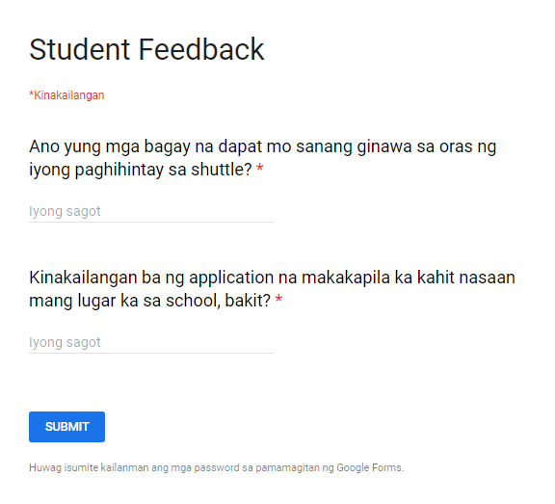
Data Gathering (Online) (50 recipients)

Slide 56
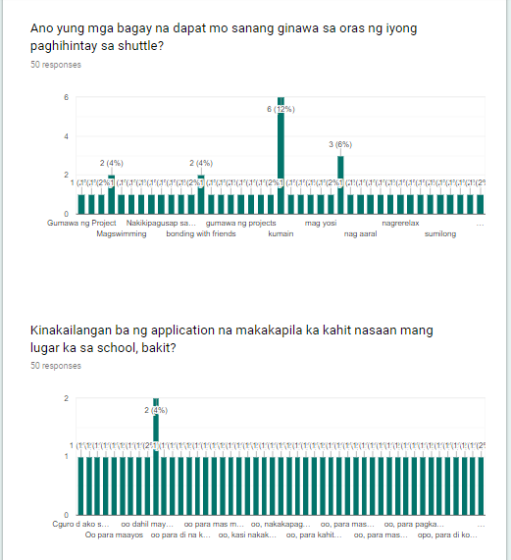
Results

Slide 57
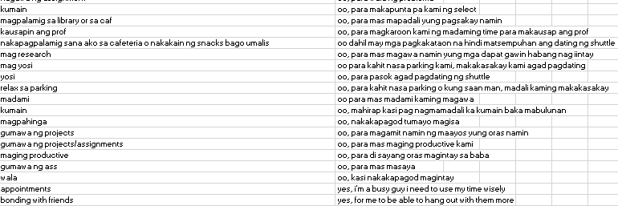
Results

Slide 58
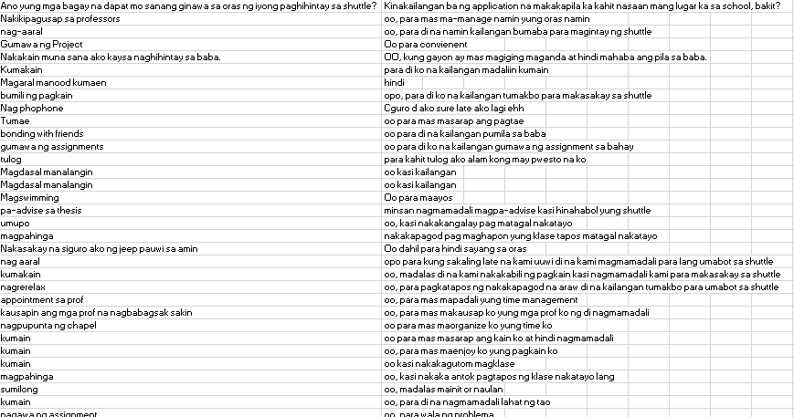
Results

Slide 59
Prototype (Screenshots)

Slide 60
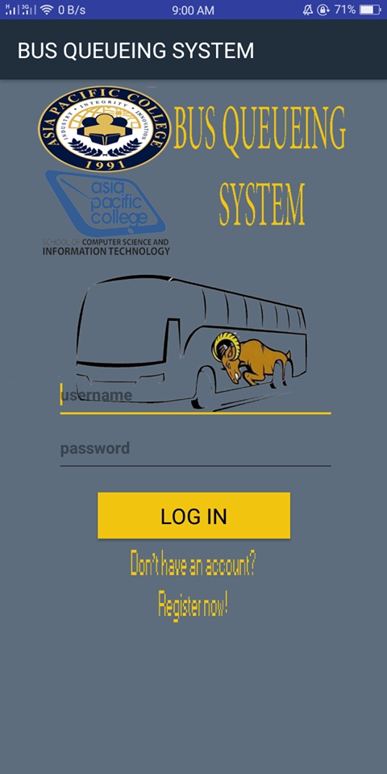
Login Interface

Slide 61
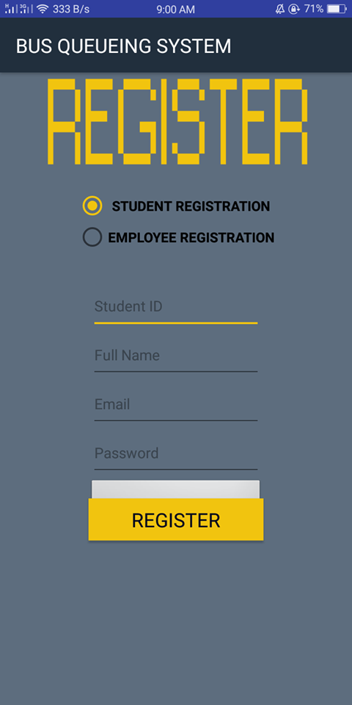
Register as Student

Slide 62
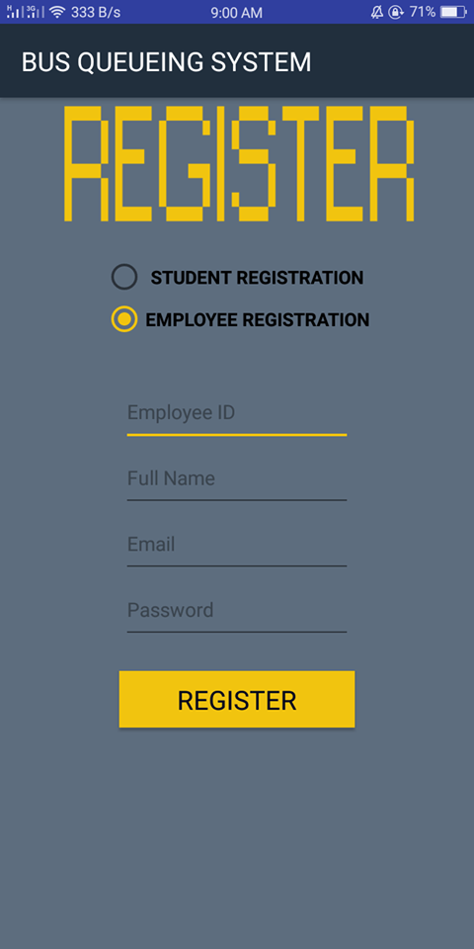
Employee Registration

Slide 63
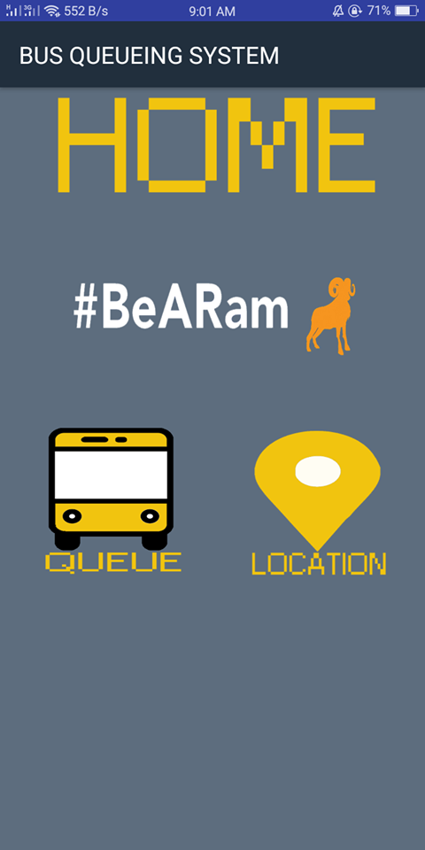
Home Page

Slide 64
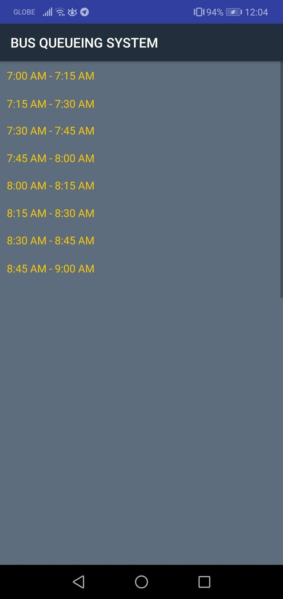

Slide 65
